Slide 1
Generating Synthetic Microstructures w/ DREAM.3D:
An Overview Tutorial
Dr. Michael A. Groeber
Materials Research Scientist
AFRL/RXCM
Collaborators:
Mike Jackson, Sean Donegan, Somnath Ghosh, Anthony Rollett, Joe Tucker, Marc DeGraef, Patrick Callahan

Slide 2
Outline
Introduction/Background
  Goal/Need from Data Flow Perspective
  What are Synthetic Builders
  Brief History of Methods and Tools Used
Synthetic Building Tools in DREAM.3D
  DREAM.3D’s Synthetic Building Philosophy
  Statistical Descriptions of “Features”
  Obtaining Statistics
  An Example of the Packing Process
  Highlighting the Current Spectrum of Possibilities
DREAM.3D – FFT Interaction
  Simulating Thermal Responses in Thermal Barrier Coatings
  Other Simulation Packages
Final Comments
  Thoughts on Needs for Future

Slide 3
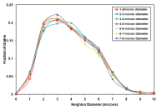
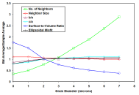
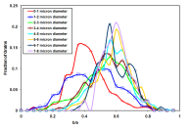
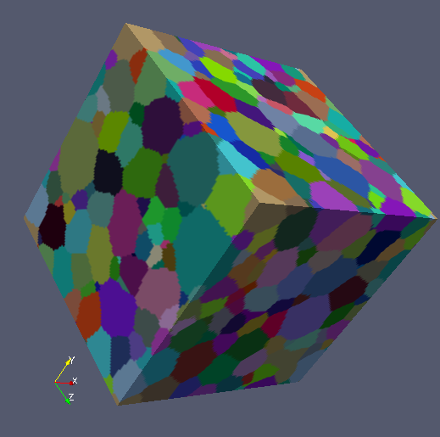

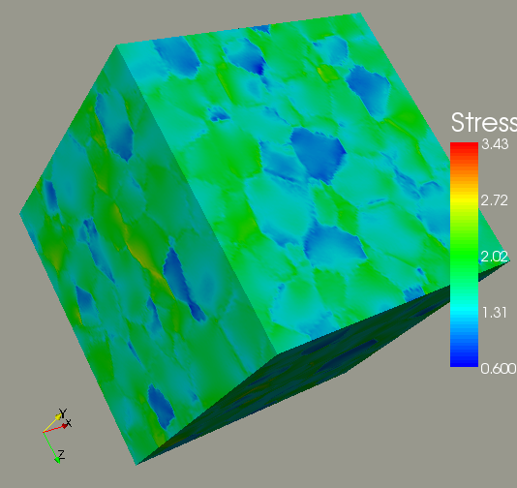
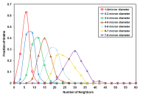
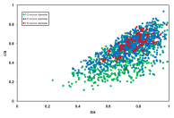
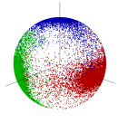

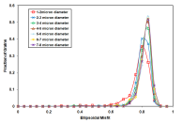
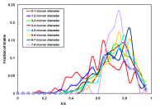
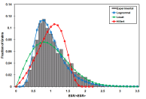


Intro: Goal / Need
Need a path to get to explicit structures from statistics/microstructure attributes
Benefits/Uses:
1) Microstructure Design 2) Scatter Due to Local Arrangements 3) Compression

Slide 4
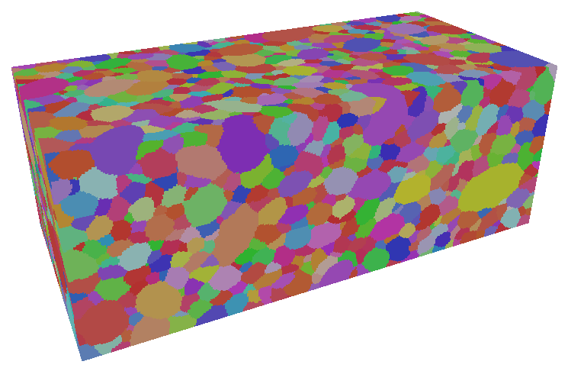
Intro: What Are Synthetic Microstructure Builders?
Computational tools capable of creating digital microstructure representations
Spatial Tessellation Tools
Physics-based Growth Models
Geometric Packing Tools

Slide 5
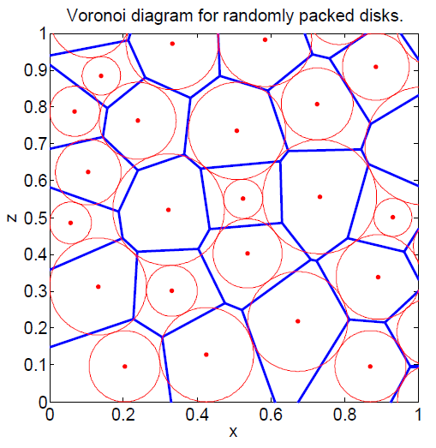
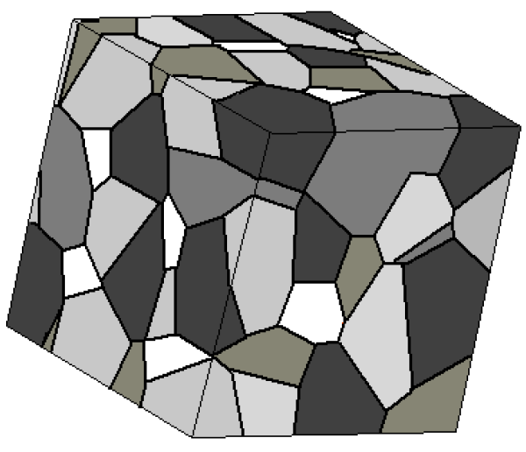
Intro: Brief History of Methods and Tools Used
Voronoi, Coster 2005
Voronoi , Gibson 2007
Spatial Tessellation Tools
Benefits
Drawbacks
Directly determined
Minimal inputs
Generally ‘non-physical’ planar boundaries
Inputs not easily tied to goal microstructure statistics
Size distributions and neighborhood variations limited/biased

Slide 6
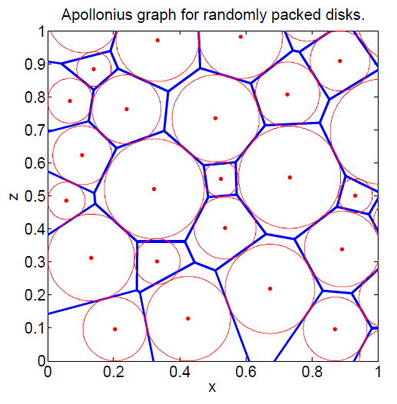
Intro: Brief History of Methods and Tools Used
Voronoi, Coster 2005
Voronoi , Gibson 2007
Appolonius, Gibson 2007
Spatial Tessellation Tools
Benefits
Drawbacks
Directly determined
Minimal inputs
Generally ‘non-physical’ planar boundaries
Inputs not easily tied to goal microstructure statistics
Size distributions and neighborhood variations limited/biased

Slide 7
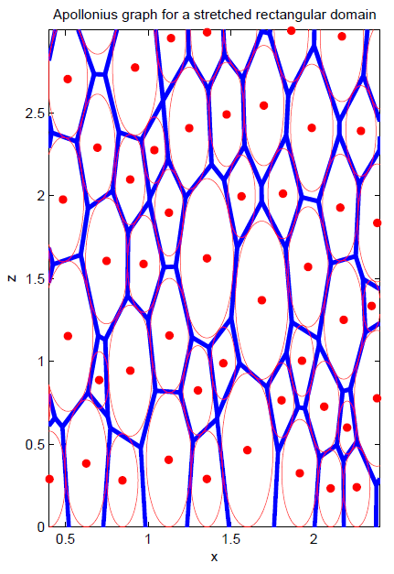
Intro: Brief History of Methods and Tools Used
Voronoi, Coster 2005
Voronoi , Gibson 2007
Appolonius, Gibson 2007
Spatial Tessellation Tools
Benefits
Drawbacks
Directly determined
Minimal inputs
Generally ‘non-physical’ planar boundaries
Inputs not easily tied to goal microstructure statistics
Size distributions and neighborhood variations limited/biased

Slide 8
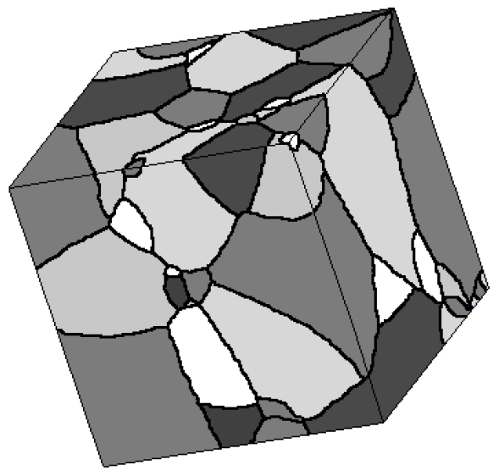
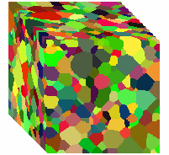
Intro: Brief History of Methods and Tools Used
Potts Model, Esche 2009
JMAK Model, Coster 2005
UMatIC, Lee 2010
Physics-based Growth Models
Benefits
Drawbacks
‘Realistic’ curved boundaries
More ‘tunable’ inputs
‘Better’ size distributions and neighborhood variations
Very complex structures possible
More computationally involved
Require material parameters or assumptions

Slide 9
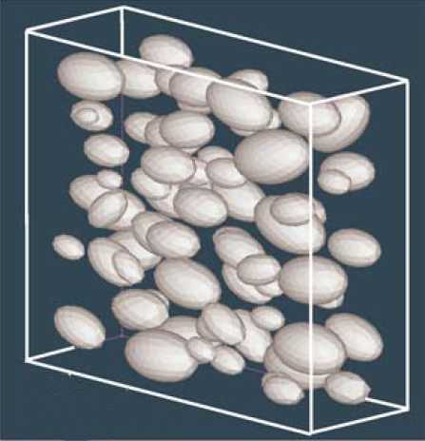
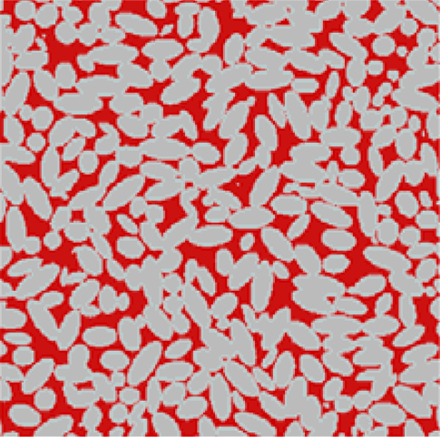
Intro: Brief History of Methods and Tools Used
Ellipsoid Particles, Chawla 2006
Ellipsoid Grains (non-space filling), Chawla 2006
Geometric Packing Tools
Benefits
Drawbacks
Multiple bases
Statistics/Empirically guided
Variable complexity
More computationally involved
Possible ‘non-physical’ boundaries
Dependent on statistics/geometric basis selected

Slide 10
Synthetic Building in D3D: Philosophy
1. Use Geometrical Objects to Represent “Features”
- Eliminates need for “physical” inputs like nucleation rate & interface/boundary mobility
- Statistics necessary become fairly straight-forward metrics feasibly measured at meso- to micro-scale with numerous experimental tools
2. Classify “Features” into “Phase Types”
- Genericizes building tools → makes material agnostic builders
- Sets “necessary statistics” describing “critical” aspects of specific “type” of “feature(s)”
3. Approach Builders as “Fast-Acting”, “Physics-ish” Models
- Exploit constraints of actual physical process to limit statistics & computational “effort”
4. Attempt to Limit Statistics to “Human-Intuitive” Metrics
- Creates limitations, biases and simplifications, but allows more user interaction

Slide 11
Synthetic Building in D3D: Statistical Descriptions
Primary Phase
Examples: Grains, Cells, Volume-filling domains
Stats: V_{f} , Size, Shape, Morph. ODF, # of Neighbors, ODF, MDF, GBCD (future)
Precipitate Phase
Examples: Non-OR Precipitates, Pores, Fibers, Carbides/Particles
Stats: V_{f} , Boundary Frac., Size, Shape, Morph. ODF, RDF, ODF, Non-Contiguous MDF (future)
Matrix Phase
Examples: Composite Matrix, Epoxy, Mean-Field Structure
Stats: V_{f}
Transformation Phase
Examples: Twins, α/β Colonies, γ‘ Precipitates
Stats: V_{f} , OR, Parent Phase, Size, Shape, Morph. ODF
Boundary Phase
Examples: Fiber Coatings, Chemically-Rich/Depleted Layers
Stats: V_{f} , Thickness, Frac. Continuous, Relative Phase Preference
Others
Boundary-Transformation Phase (G.B. α)
Discontinuous Matrix Phase (Free Si)

Slide 12
Synthetic Building in D3D: Obtaining Statistics
1. From Experimental Data
- Straight-forward for microstructures that are single-phase Primary or Matrix-Precipitate…if you have 3D data sets that have adequate resolution (WTM) & are large w.r.t. the “Features”
- Almost all other cases are much more difficult or lacking methods for obtaining them…measuring stats of “snapshots” of structures collected does not measure the “Features” being used in the synthetic process…effectively need analysis/processing tools to run “physics” in reverse.
2. Stats Generator / Other “Design” Tool
- Very easy to establish statistics → input anything you want
- Much more difficult to create “realistic” or even “possible” statistics
· no sanity-check to statistics entered (within SG)
· often statistics are not independent, but may not
be intuitively linked

Slide 13
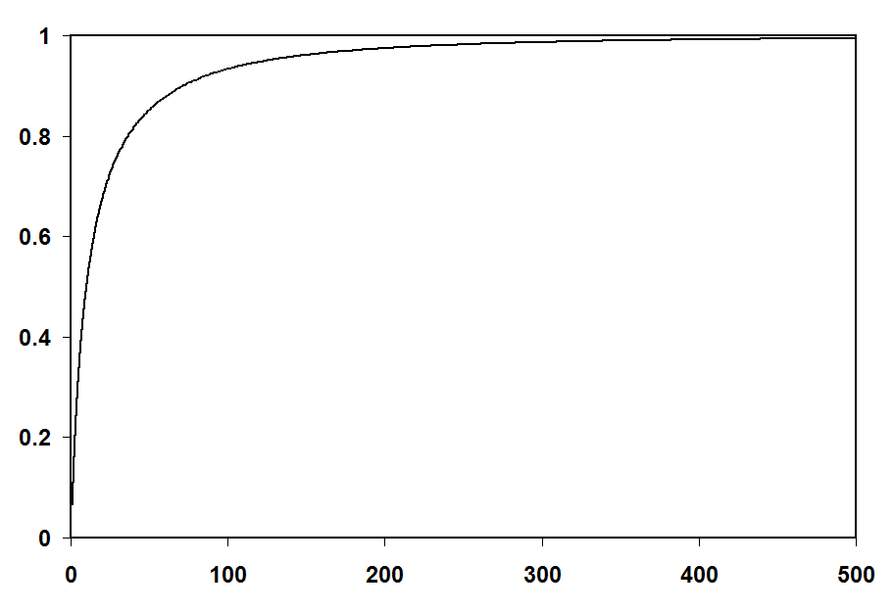
Synthetic Building in D3D: An Example
Grain Descriptions (Geometric Shapes)
Probability
Grain Volume
Grains/Features defined by size, shape and orientation (morphological)
Shape and orientation can be correlated to size

Slide 14
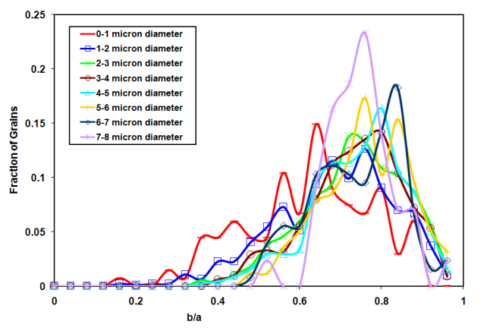
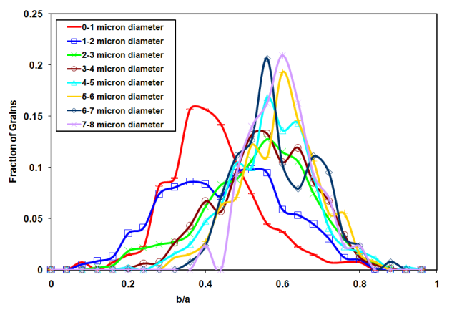
Synthetic Building in D3D: An Example
Grain Descriptions (Geometric Shapes)
Probability
Probability
Grain Volume
b/a
Probability
c/a
Grains/Features defined by size, shape and orientation (morphological)
Shape and orientation can be correlated to size

Slide 15
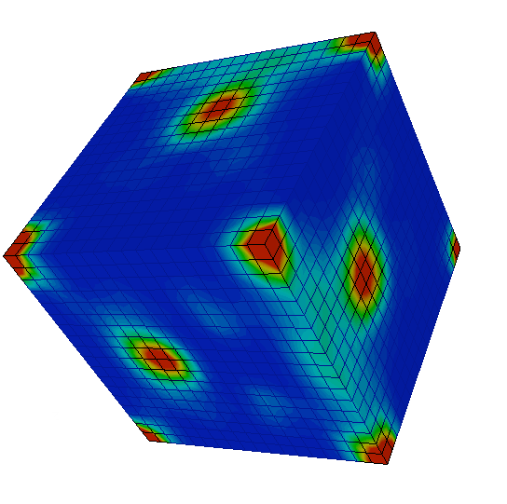
Synthetic Building in D3D: An Example
Grain Descriptions (Geometric Shapes)
Probability
Probability
Grain Volume
b/a
φ₁
Probability
Φ
φ₂
c/a
Grains/Features defined by size, shape and orientation (morphological)
Shape and orientation can be correlated to size

Slide 16
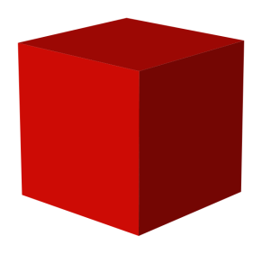
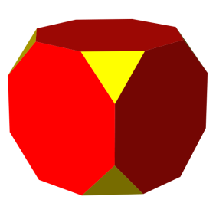
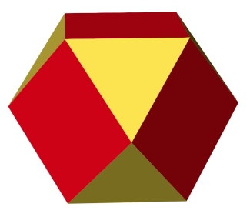
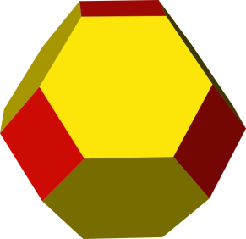
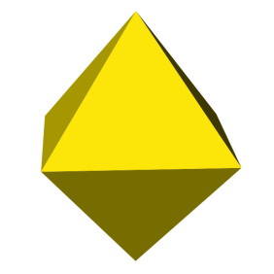
Synthetic Building in D3D: An Example
Grain Descriptions (Geometric Shapes)
z
↑ γ
c
y
a
b
x
Ellipsoids
Curved boundary
No inherent # of neighbors
Only aspect ratios needed
Super-Ellipsoids
Curved+faceted boundaries
6, 8 or no inherent # of neighbors
Ω₃ linked to exponent, n
Cube-Octahedra
Faceted boundaries
6, 8 or 14 neighbors
Ω₃ linked to clipping depth, γ
Shape is difficult to describe and in the limit requires infinite details
Shape classes or bases allow for lower order descriptors to fully define shapes

Slide 17


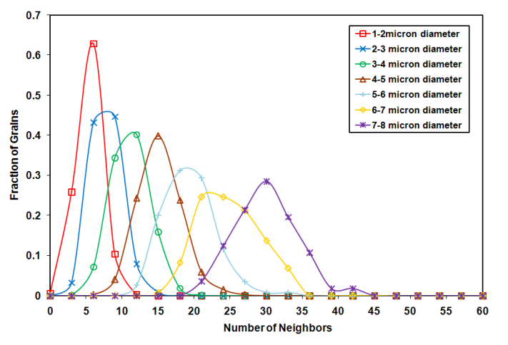

Synthetic Building in D3D: An Example
Packing Techniques and Neighborhood Quantification
swap
OR
switch
Geometric features are placed and moved in a Monte Carlo fashion while attempting to optimize space filling and local feature arrangement (neighborhoods)
During packing care must be taken to limit biases

Slide 18
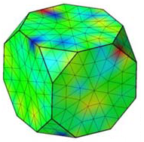

Synthetic Building in D3D: An Example
Texture Matching (ODFs, MDFs, GBCDs)
swap
OR
change
Similar to feature packing, orientation placement and rearrangement follows a Monte Carlo process while attempting to match both the ODF and MDF
- GBCDs have only been matched for random structures with a coherent Σ3 twin peak

Slide 19
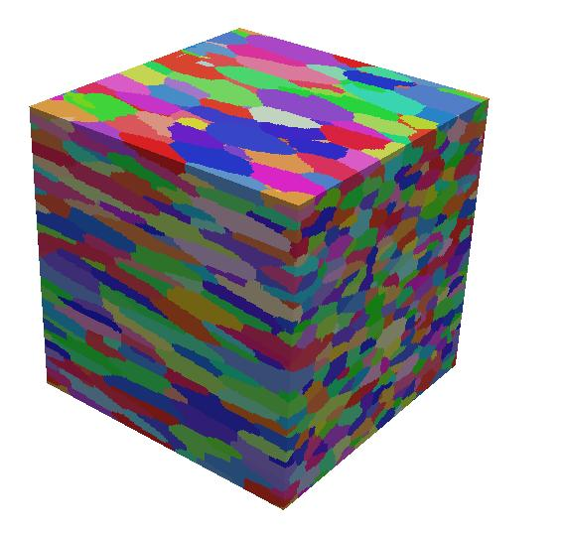
Synthetic Building in D3D: Current Possibilities
Equiaxed Grains
Rolled Grains
Precipitates

Slide 20
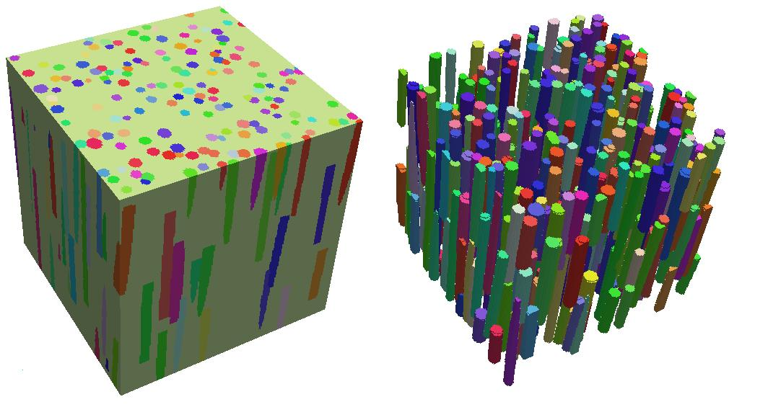
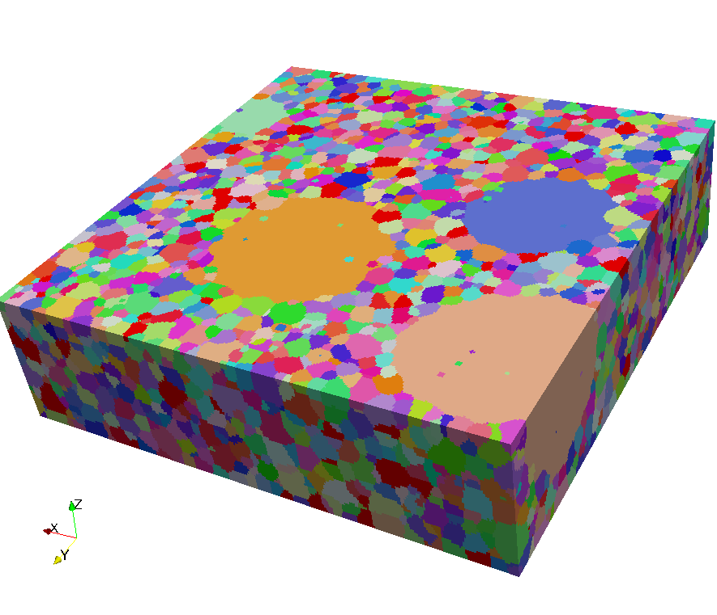
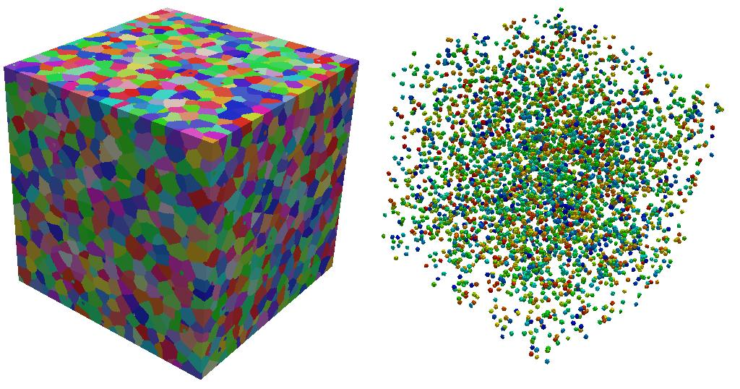
Synthetic Building in D3D: Current Possibilities
Fiber Composites
Bimodal Features/ALA Grains/MTRs
Carbides/Nano-particles/Porosity

Slide 21
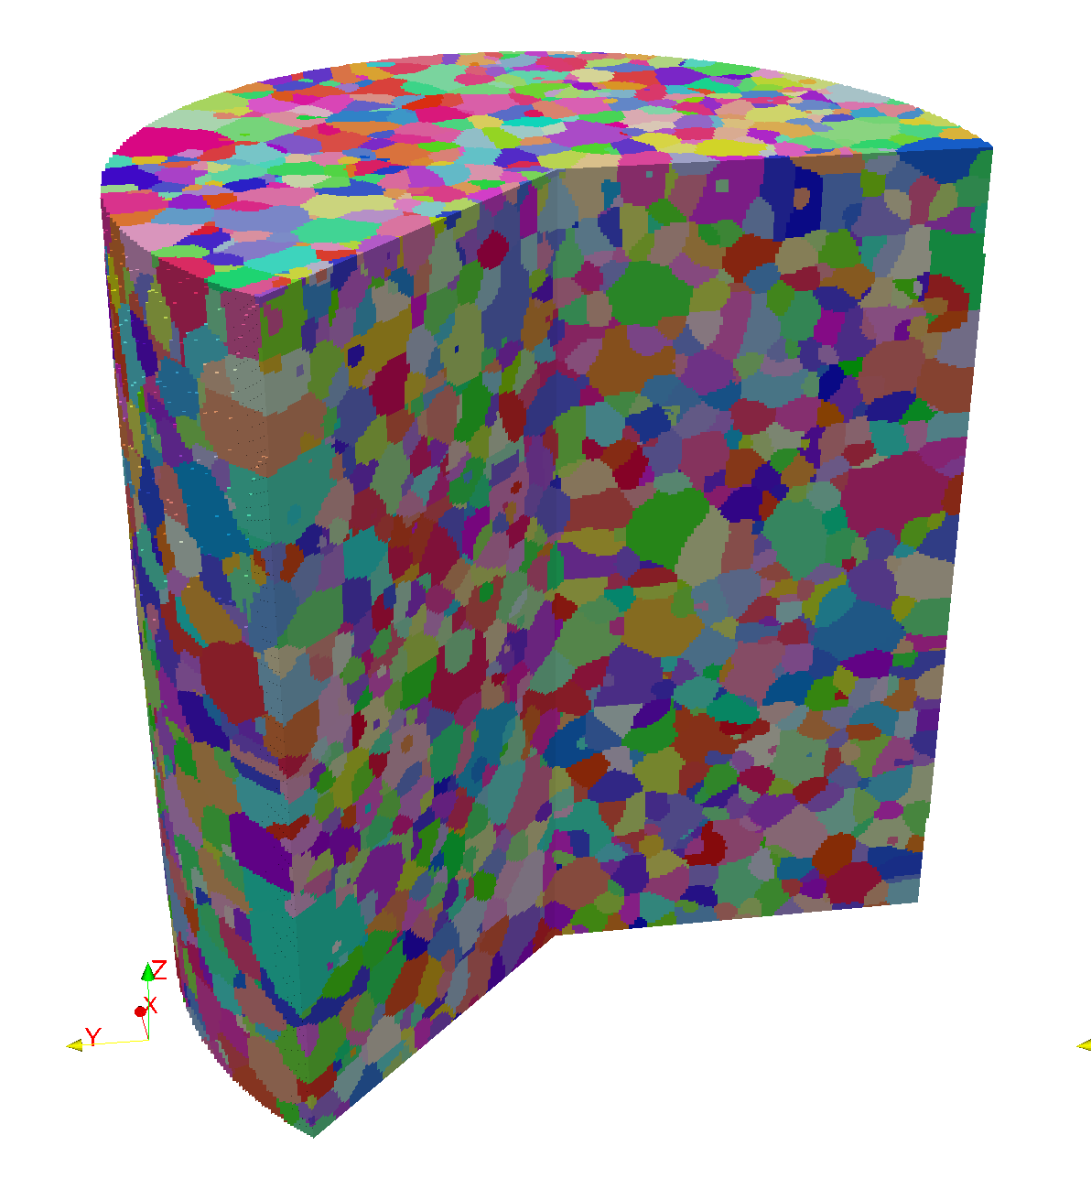
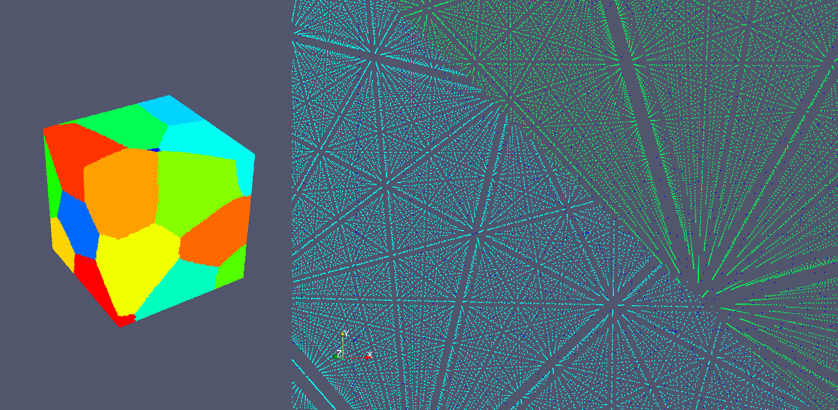
Synthetic Building in D3D: Current Possibilities
Polycrystalline Atomistics Structure
Far-Field HEDM
(Data informed synthetic)

Slide 22
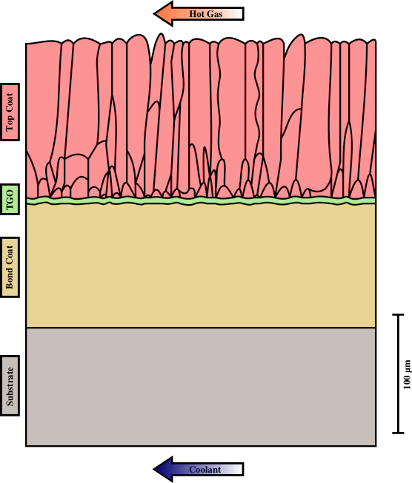
DREAM.3D – FFT Interaction: TBC Structure

Slide 23
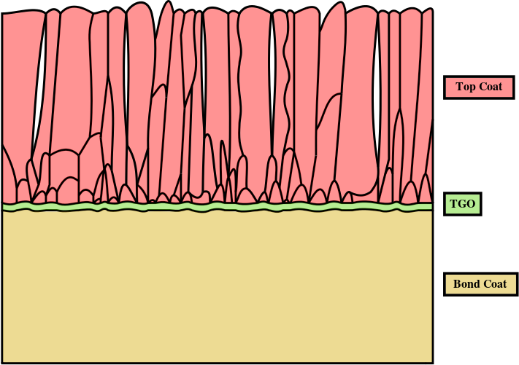
DREAM.3D – FFT Interaction: TBC Structure
EB-PVD TBC

Slide 24
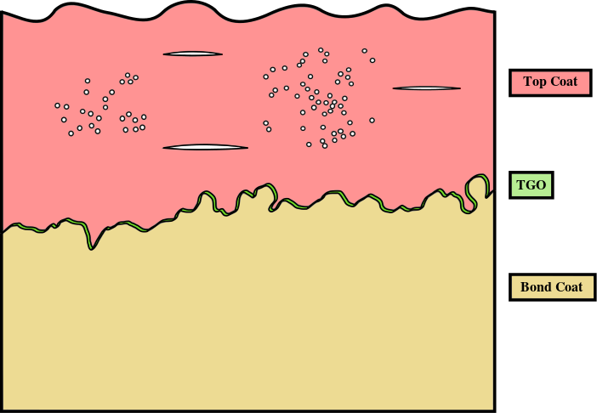
DREAM.3D – FFT Interaction: TBC Structure
APS TBC

Slide 25
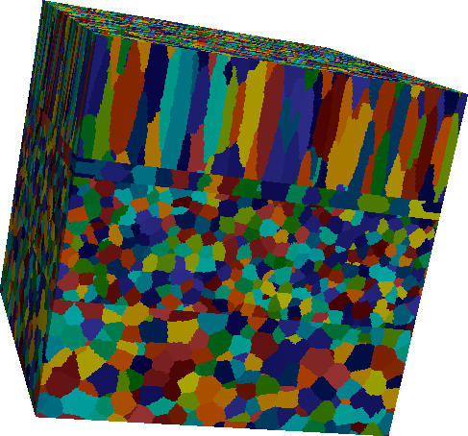
DREAM.3D – FFT Interaction: Synthetic TBCs
TC
TGO
BC
substrate

Slide 26
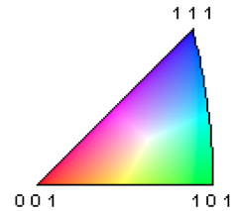
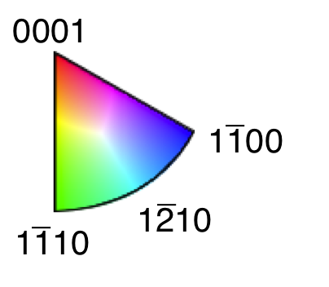
DREAM.3D – FFT Interaction: Synthetic TBCs
TGO: no texture
TGO: texture

Slide 27
DREAM.3D – FFT Interaction: Synthetic TBCs
TC
TGO
BC
phase maps
localized Potts model

Slide 28
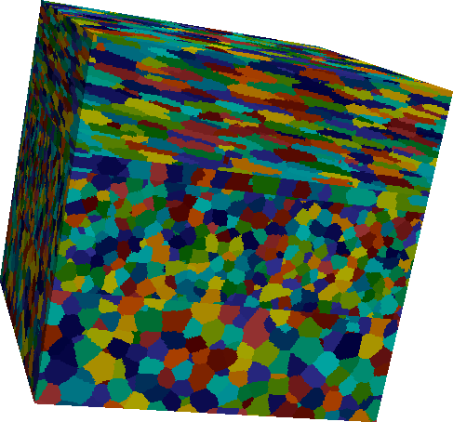
DREAM.3D – FFT Interaction: Synthetic TBCs
columnar top coat
splat top coat
High resolution structures consisting of 315³ Fourier grids (~31 million Fourier points. Variation in top coat morphology, TGO texture, bond coat material, and interface roughness.

Slide 29
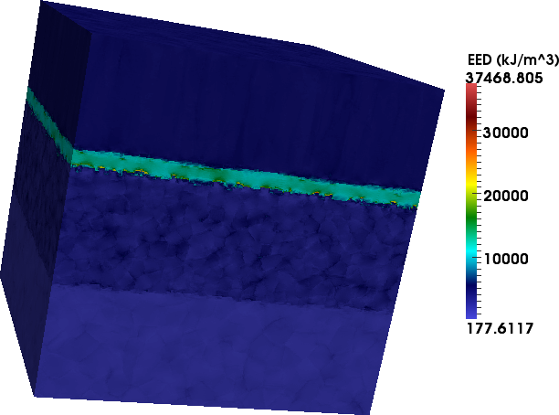
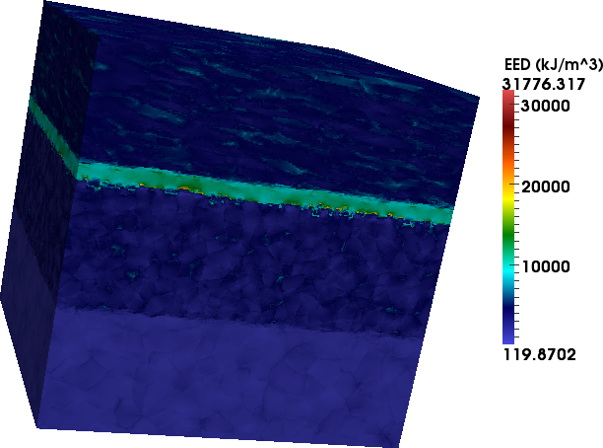
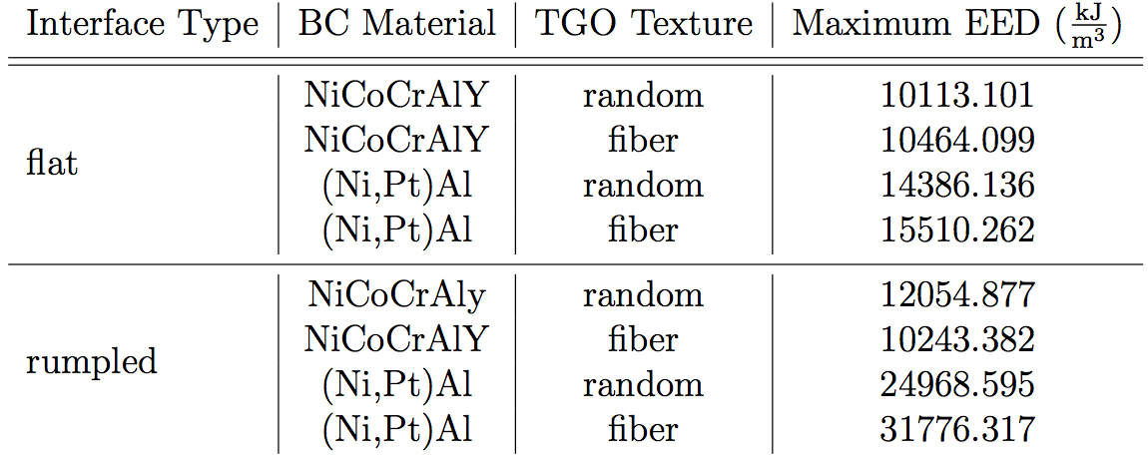
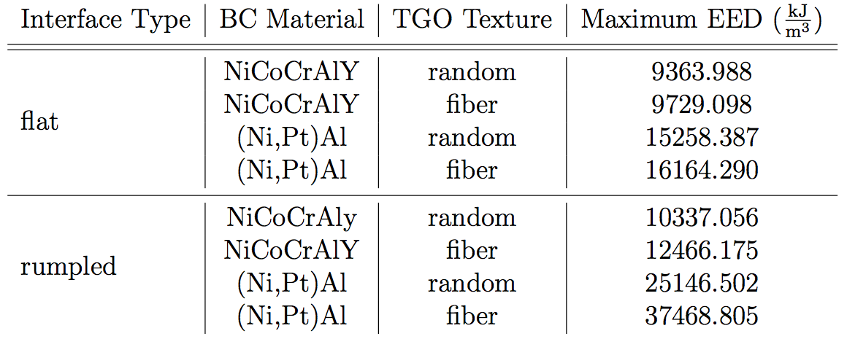
DREAM.3D – FFT Interaction: Stress Analysis
columnar top coats
splat top coats
columnar top coat, textured TGO, (Ni,Pt)Al bond coat
splat top coat, textured TGO, (Ni,Pt)Al bond coat
Majority of EED contained in the TGO. Structures with rumpled interfaces display systematically larger peak stresses.

Slide 30
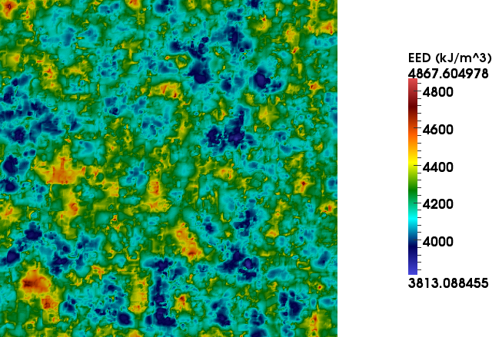
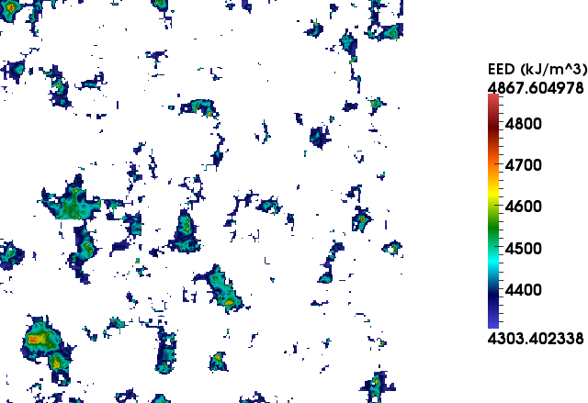

DREAM.3D – FFT Interaction: Hot Spot Correlation
contour map
z-smooth EED
POT
quantify hot spots

Slide 31


DREAM.3D – FFT Interaction: Hot Spot Correlation
columnar top coat, textured TGO, (Ni,Pt)Al bond coat
splat top coat, textured TGO, (Ni,Pt)Al bond coat
Hot spots at the BC/TGO interface generally lie in regions of low elevation (i.e., troughs)

Slide 32


DREAM.3D – FFT Interaction: Hot Spot Correlation
columnar top coat, textured TGO, (Ni,Pt)Al bond coat
splat top coat, textured TGO, (Ni,Pt)Al bond coat
Hot spots at the TGO/TC interface do not display a consistent trend with elevation, though the largest lie in regions of high elevation (i.e., ridges).

Slide 33


DREAM.3D – FFT Interaction: Hot Spot Correlation
columnar top coat, textured TGO, (Ni,Pt)Al bond coat
splat top coat, textured TGO, (Ni,Pt)Al bond coat

Slide 34


DREAM.3D – FFT Interaction: Hot Spot Correlation
columnar top coat, textured TGO, (Ni,Pt)Al bond coat
splat top coat, textured TGO, (Ni,Pt)Al bond coat

Slide 35
Final Comments: Thoughts and Future Needs
Thoughts
Synthetic structures are a powerful tool for obtaining many, many instances of a microstructure and may be critical in determining what aspects of the microstructure are important for a given property
Synthetic structures can also serve as “phantoms” for testing and understanding our workflows and analysis/processing tools
Future Needs
We need a lot of development in our tools with respect to transformation and boundary phases
We need a lot of work/thought on defining the appropriate “set” of attributes that define the “local state”
We could benefit from coupling the current tools with “real physics-based” tools for “healing” our best efforts

