Slide 1
Working with “Big” Materials Data in a Common Integrated Environment
Correlative Analysis for Materials Engineering Using DREAM.3D
2015 UCSB Workshop on Collection and Analysis of Big Data
in 3D Materials Science
Sean Donegan, Mike Groeber, Mike Jackson, & Dennis Dimiduk
May 13, 2015

Slide 2
Outline
Introduction
  What is “big” materials data?
“Big” Data Management
  Understanding and Exploiting DREAM.3D
Data Flow in Materials Engineering
  Enabling materials design
Connecting to Other Software Packages
  Bridging to SPPARKS
Summary

Slide 3
What is “Big” Data?
Big data is a broad term for data sets so large or complex that traditional data processing applications are inadequate - Wikipedia
What does this mean in a materials context?
Big materials data is any collection of data, descriptive about materials, that satisfies any of the following:
The physical size of the data requires use of more powerful computers to analyze
  E.g. Large scale BSE image montages
The physical size of the data requires modification of existing algorithms
  E.g. Computation of orientation field curl
The connections between various data sets make an overall data space that satisfies either 1. or 2.
  E.g. Data flow between experiments and simulation; examples today with SPPARKS!
Software tools exist to help!
Notes:
Also mention hardware, especially storage > FreeNAS, etc.

Slide 4
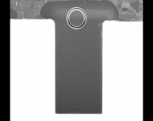
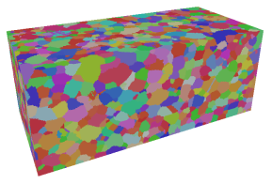






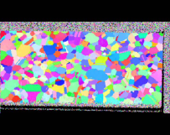



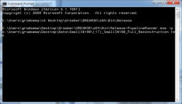
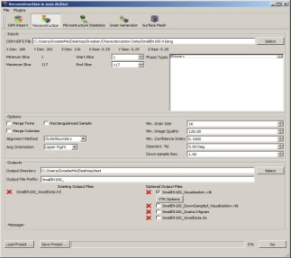













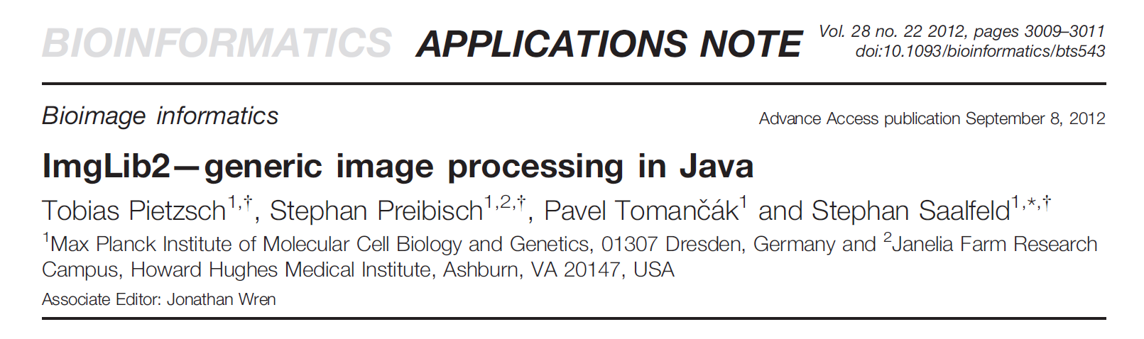
The Evolution to DREAM.3D
Early-to-Mid 2000s
  Proof of concept for automated 3D structure quantification – Led to disparate command line tools
Mid-To-Late 2000s
  GUI front end – Improved user interaction, but fixed workflow and structures
V1.0
Late 2000s and Early 2010s
  Large collaborative efforts – Added function, but occurred manually & with point source integration
V2.0-3.0
2015
2003
2005
2007
2009
2011
2013
Early-To-Mid 2010s
  Abstracted tool interaction and data structure – Greatly lowered barrier to entry and expanded breadth of application
*Adapted from M. Groeber
Notes:
4

Slide 5

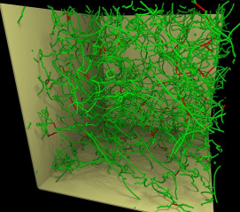
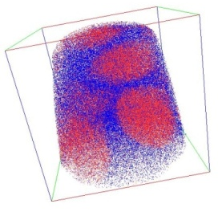
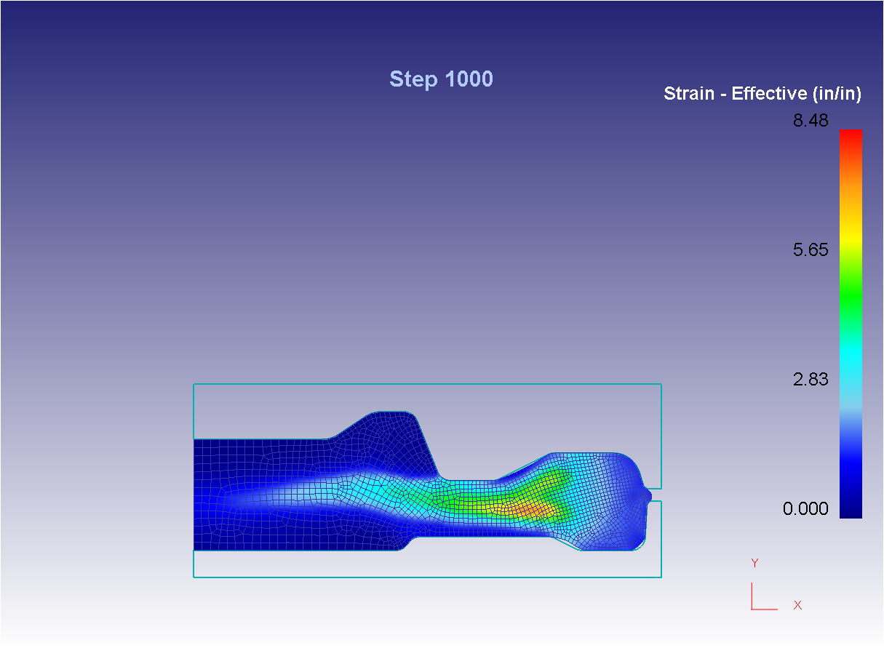
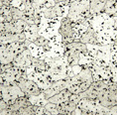
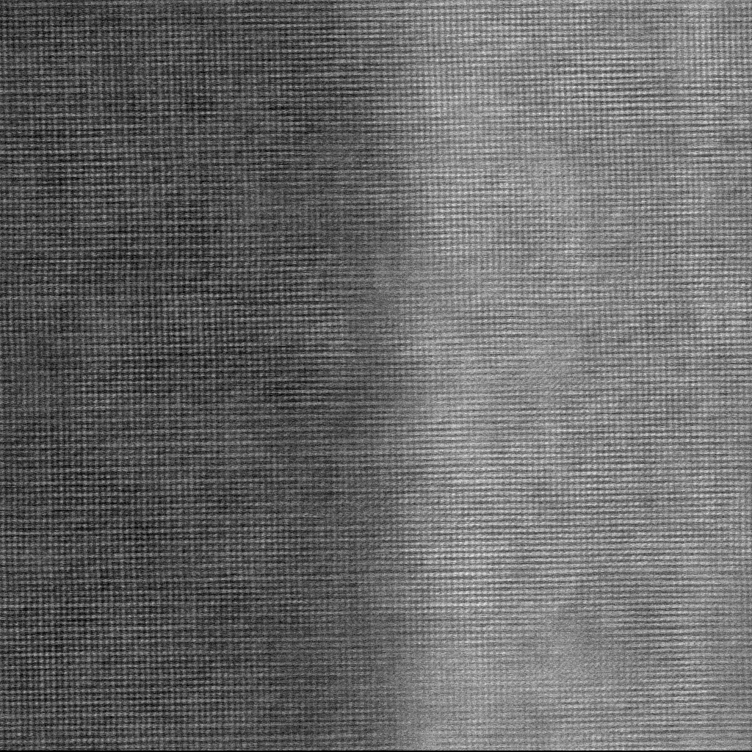
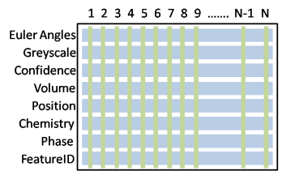
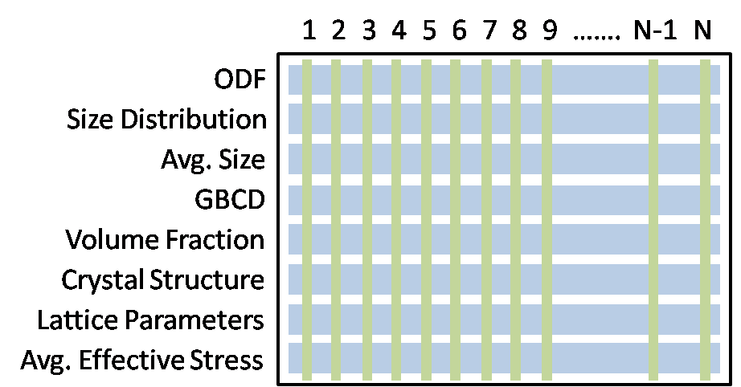
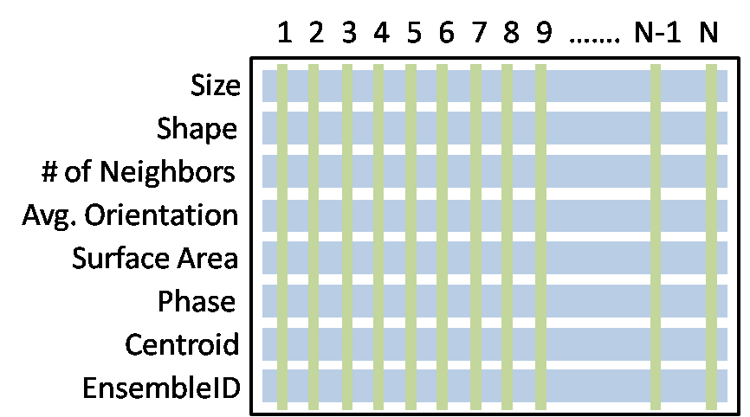
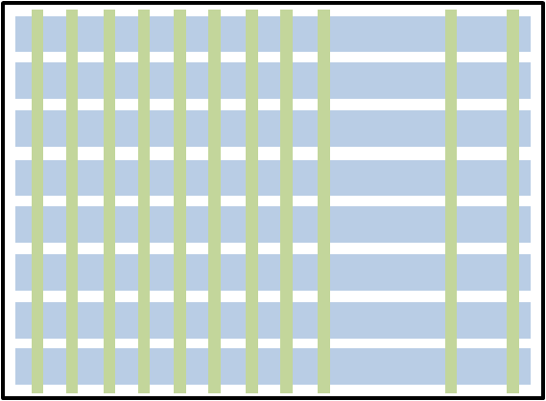
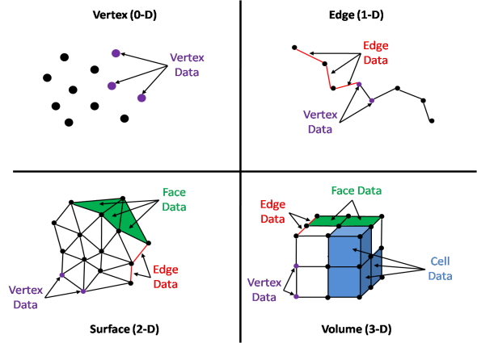

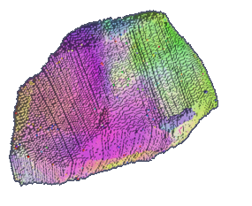
DREAM.3D
Images Courtesy of J. Tiley
Image Courtesy of J. Miller
γ'
γ
Image Courtesy of L. Drummy
GEOMETRY, LABELING, STATISTICS
Feature Object
Ensemble Object
Element Object
100s – 10,000s of Objects
(100s – 10,000s of Element Objects)
1s – 10s Objects
(100s – 10,000s of Feature Objects)
100,000s – 1,000,000,000s of Objects
Object–Attribute construct generalizes storage of digital, spatial information
*Adapted from M. Groeber

Slide 6
Attribute Matrix Layout
Dynamically-defined & resized container allows for flexible & efficient data storing
Objects
1
…….
2
3
4
5
6
7
8
9
N-1
N
Position
Attribute Array
Greyscale
Confidence
Attributes
Volume
Quaternion
Chemistry
Phase
Property Vector
FeatureID
*Adapted from M. Groeber

Slide 7
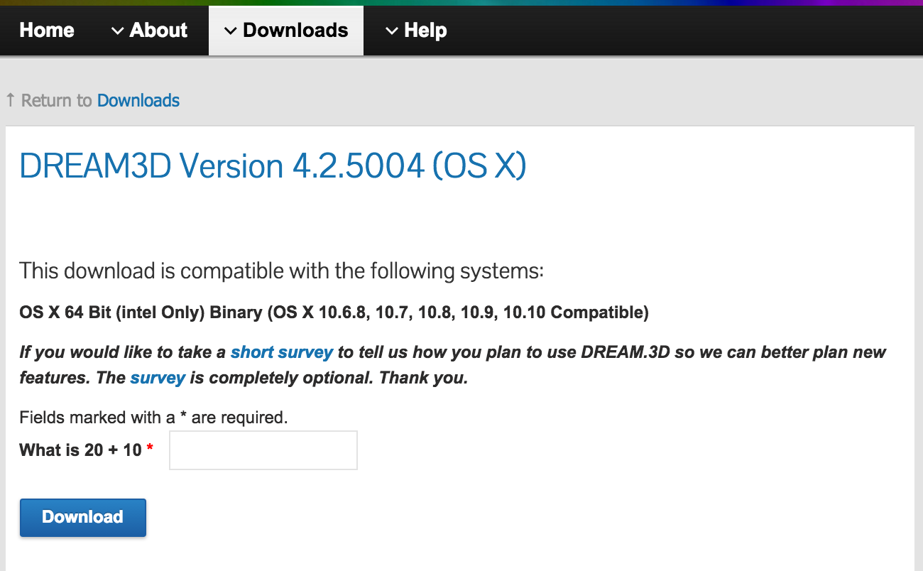
Getting DREAM.3D
Current distributed version is v4.2.5004
dream3d.bluequartz.net
github.com/dream3d/dream3d
But support for v4.x will cease once v5.x is released!
dream3d.bluequartz.net/binaries/experimental
Notes:
Mention release date; where to get nightlies; nightlies are unstable!; interest in being able to compile; Threaded > parallel; shared memory, want distributed; GPU computing; open source > academic integration (rotations example); plugin architecture

Slide 8
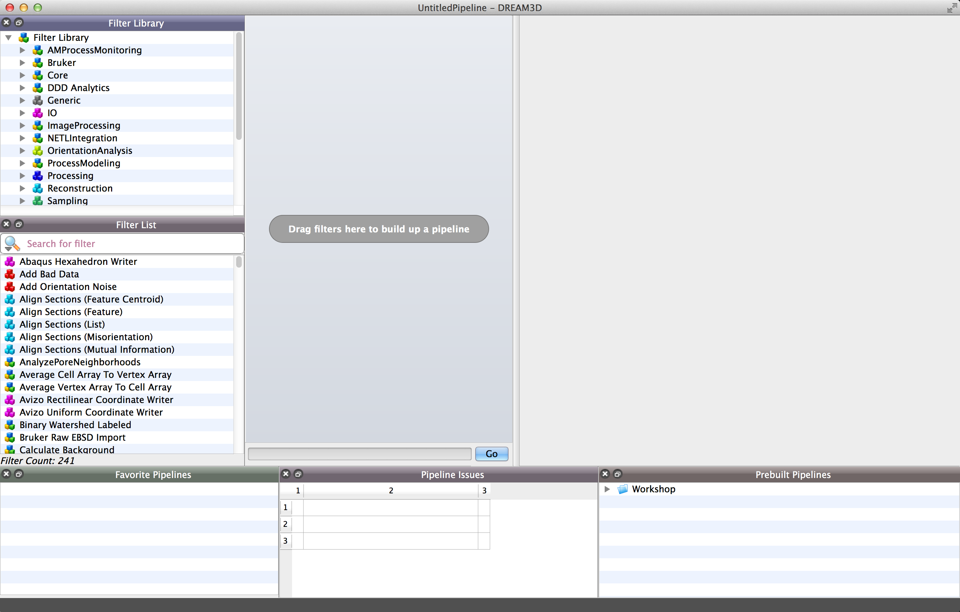
The DREAM.3D Interface
Easier to see it in action…

Slide 9
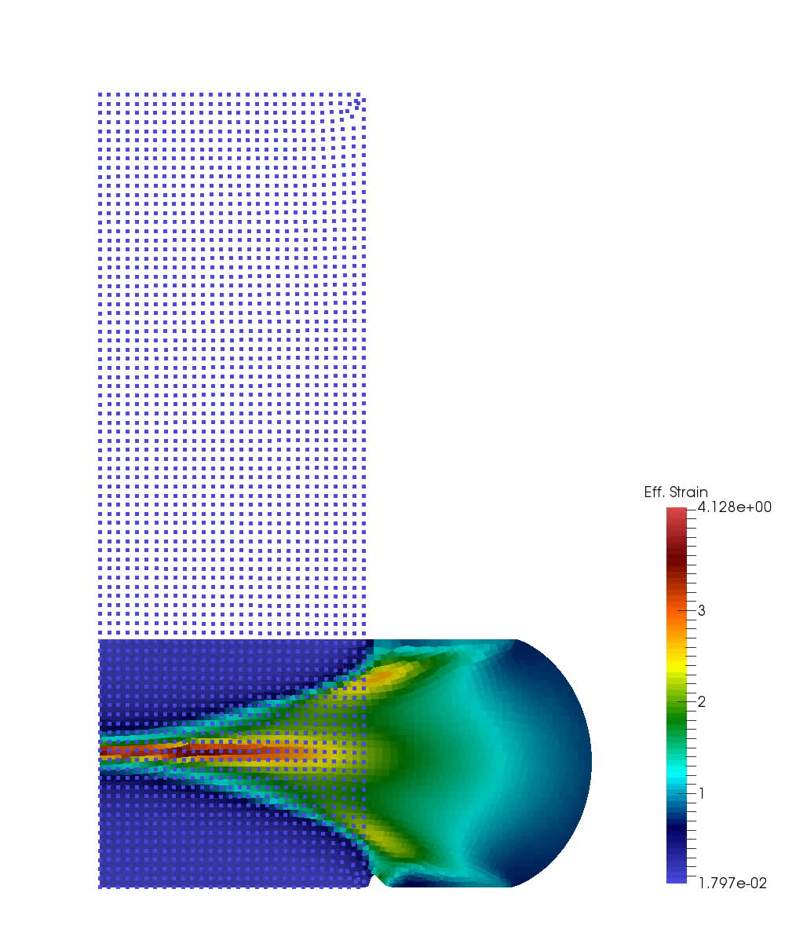
A “Big” Data Problem
Modern materials engineering is driven by process modeling
Process modeling tools such as DEFORM and ProCAST produce continuous descriptions of field variables at the part geometry scale
Desire to predict part performance from simulated processing to meet specification
*Data courtesy of A. Pilchak

Slide 10
Process Model Data Flow
Iterative Shape Design (CAD)
Finished Shape (CAD)
Sonic Shape (CAD)
?
Forging Shape (CAD)
Cutup Plan & Validation (CAD)
Process Model (Mesh)
---- OEM
---- Forging Supplier
Continuum Field Variables (Mesh)
*Adapted from D. Dimiduk

Slide 11
Process Model Data Flow
OEMs compare specimen properties to databases to evaluate specifications
No direct connection between CFVs and cutup plans
Disconnect between materials engineering and part design!
Finished Shape (CAD)
?
Need for a workflow that directly integrates materials and design
Requires knowledge of spatially resolved microstructure (RVEs) to drive smart validation and part shape iterations
Categorization of RVEs driven by regions (zones) of common thermomechanical processing
Cutup Plan & Validation (CAD)
Continuum Field Variables (Mesh)

Slide 12
Process Design
Continuum Field Variables
Process Models
Part Design
Sonic Shape (CAD)
Forging Shape (CAD)
Finished Shape (CAD)
Iterative Shape Design (CAD)
Need to complete the loop between part design and property validation
Cutup Plan
Generate zones for RVEs

Slide 13
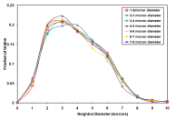
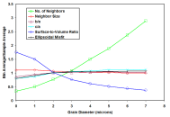
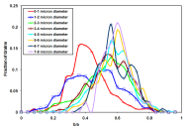
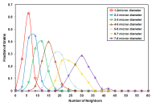
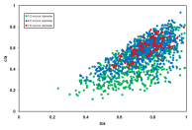
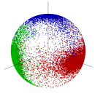
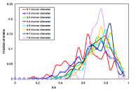
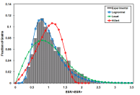
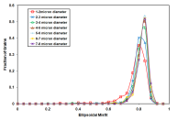
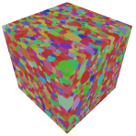
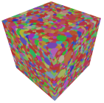
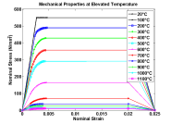
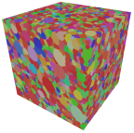
Process Design
Continuum Field Variables
Process Models
Part Design
Characterization
Data Fusion
Microstructure Model
Microstructure
Properties
Property Model
Optimization
*Adapted from M. Groeber

Slide 14
Process Design
Continuum Field Variables
Process Models
Part Design
Characterization
Data Fusion
Microstructure Model
Microstructure
Properties
Property Model
Optimization

Slide 15
Data Management
Continuum Field Variables
Process Models
Require a data structure capable of analyzing, correlating, and archiving spatiotemporal data on disparate topologies in arbitrary dimensions (e.g., CAD representations, polygonal meshes, images, etc.)
Experimental measurements, CAD representations, and simulation geometries need to be registered to enable correlation
Require the ability to agglomerate geometry elements into zones and assign properties to these zones, then associate zones to form collections of zones, and so on, up to the part mold line (microscale to macroscale)
The toolset used needs to enable a hierarchical, relational data structure capable of ingesting arbitrary grid topologies and dimensionalities

Slide 16
Process Design
Continuum Field Variables
Process Models
Part Design
Characterization
Data Fusion
Microstructure Model
Microstructure
Properties
Property Model
Optimization

Slide 17
Domain Partitioning
Domain partitioning (or zoning) divides a space into regions that are “similar”, by some metric
Want to automatically extract those regions of a CFV that are more alike one another than any other region
These zones are then considered to have undergone the same thermomechanical processing and therefore to have similar microstructure and properties
Parallels to image segmentation, cluster analysis, discrete geometry, etc.

Slide 18
Stochastic Examples
k-means
k-means and k-medoids produce nearly identical results when zoning scalar fields
k-medoids is the more expensive approach due to optimization across all within-cluster points
Zones produced generally follow contour lines of original CFV
k-medoids

Slide 19
Stochastic Examples
k-means
DEFORM can produce point tracking data that tracks material points and CFVs through time
Generic data structure allows applications of algorithms to arbitrary grid topologies
k-means and k-medoids again produce nearly identical results
k-medoids

Slide 20
Future Directions
Determining the optimal number of zones can be difficult; algorithms exist that determine the number of zones automatically, but are more sensitive to other input parameters
Want to avoid the “curse of dimensionality”, where many distance metrics begin to lose meaning in very high dimensional space
Zones in CFVs should be those regions with the smallest gradient…
Scalar segmentation
Compute gradient
Cleanup small zones

Slide 21
Process Design
Continuum Field Variables
Process Models
Part Design
Characterization
Data Fusion
Microstructure Model
Microstructure
Properties
Property Model
Optimization

Slide 22
Supplemental Slides

Slide 23
Zoning Approaches
Stochastic approaches based on clustering algorithms are simple to implement and provide an intuitive way to generate zoning schemes
Randomly select initial point values to serve as the means
Assign each point to the closest mean value
Calculate the new means for each cluster
Repeat 2. and 3. until the mean does not change
k-means clustering
Randomly select initial point values to serve as the medoids
Assign each point to the closest medoid value
Within each cluster, swap the medoid to every other point to find the medoid that minimizes the distance to each other point in that cluster
Repeat 2. and 3. until the medoids do not change
k-medoids clustering

Slide 24
Stochastic Examples
The distance metrics can operate in higher dimensional space, allowing zoning across multi-component CFVs, multiple CFVs at once, or CFVs through time
k-means
Can apply weights to variables if possessing some a priori idea about contributions
k-medoids produces “cleaner” zones in higher dimensional space compared to k-means
k-medoids

Slide 25
Zone Fidelity
Which is a “better” zoning?
Metrics exists to measure the fidelity of a partitioning based on how much information has been lost
Silhouette

Slide 26
Zone Fidelity
Silhouette allows for a visual inspection of the different partition schemes, or optimization of k by maximizing the silhouette

Slide 27
Process Design
Continuum Field Variables
Process Models
Part Design
Characterization
Data Fusion
Microstructure Model
Microstructure
Properties
Property Model
Optimization

Slide 28
Characterization
Obtained BSE image montage of entire cross-section of pancake forging
Possess DEFORM simulation of exact conditions for forging
Montage has ~20% overlap and has had stitching coordinates determined in Fiji
Workflow implemented in DREAM.3D:
Import registered image montage tiles
Stitch images into one contiguous array using pre-determined stitching coordinates
Calculate background and perform background subtraction
Coarsen image data to scale resolution to the DEFORM simulation
Each tile is 2048 x 2048, total 979 tiles, montage dimensions of 89493 x 28995
*Data courtesy of M. Uchic

Slide 29
Montage Workflow
Import into DREAM.3D
Calculate background and perform subtraction
Stitch images
Threshold to segment phases
Perform quilting to coarsen resolution

Slide 30
Future Directions
Improvements in montage workflow:
Reduce discontinuity between tiles
  Take advantage of 20% tile overlap to create blending schemes
Improve background subtraction
  Ignore pixels that lie outside the part geometry to improve estimation of background
Add additional statistics to quilting
  Maximum, minimum, standard deviation, variance, directionality of particles via Fourier transforms, etc.
Characterization
Data Fusion
Need to register image montage to DEFORM simulation, using built in DREAM.3D functionality to scale, translate, rotate, and warp underlying grids
Can register the geometries “manually” (e.g., by direct manipulation in ParaView) as a start, but desire is to semi-automate the process
Use experience building workflow for image data to fuse other experimental data, such as NDE measurements

Slide 31
Future Directions
Continuum Field Variables
Process Models
Part Design
Characterization
Data Fusion
Microstructure Model
Microstructure
Properties
Property Model
Optimization

